Slide 1
REDLINE
Odoo ERP Implementation
Medical Supplies & Equipment Trading
Graduation Project Defense
ريد لاين للتجارة في المستلزمات والمعدات الطبية
مشروع تخرج: تطبيق نظام أودو لتخطيط موارد المؤسسات
Team
Mohamed Mahmoud Abdel Bary - Team Leader - Apps, Settings, Permissions & Design
Mohamed Essam El-Din Youssef - Sales & CRM
Ahmed Mahmoud Mohamed - Inventory & Data Upload
Fathy Adel Fathy - Purchase, Quality & Testing
Omnia Haitham - Accounting & Finance
Prepared 25 October 2026 | Business period 1 May 2026 – 30 September 2026 | Odoo 19.0 (Enterprise edition assumed)
All companies, partners and transactions are simulated; nothing was installed or tested on a live Odoo server.

Slide 2
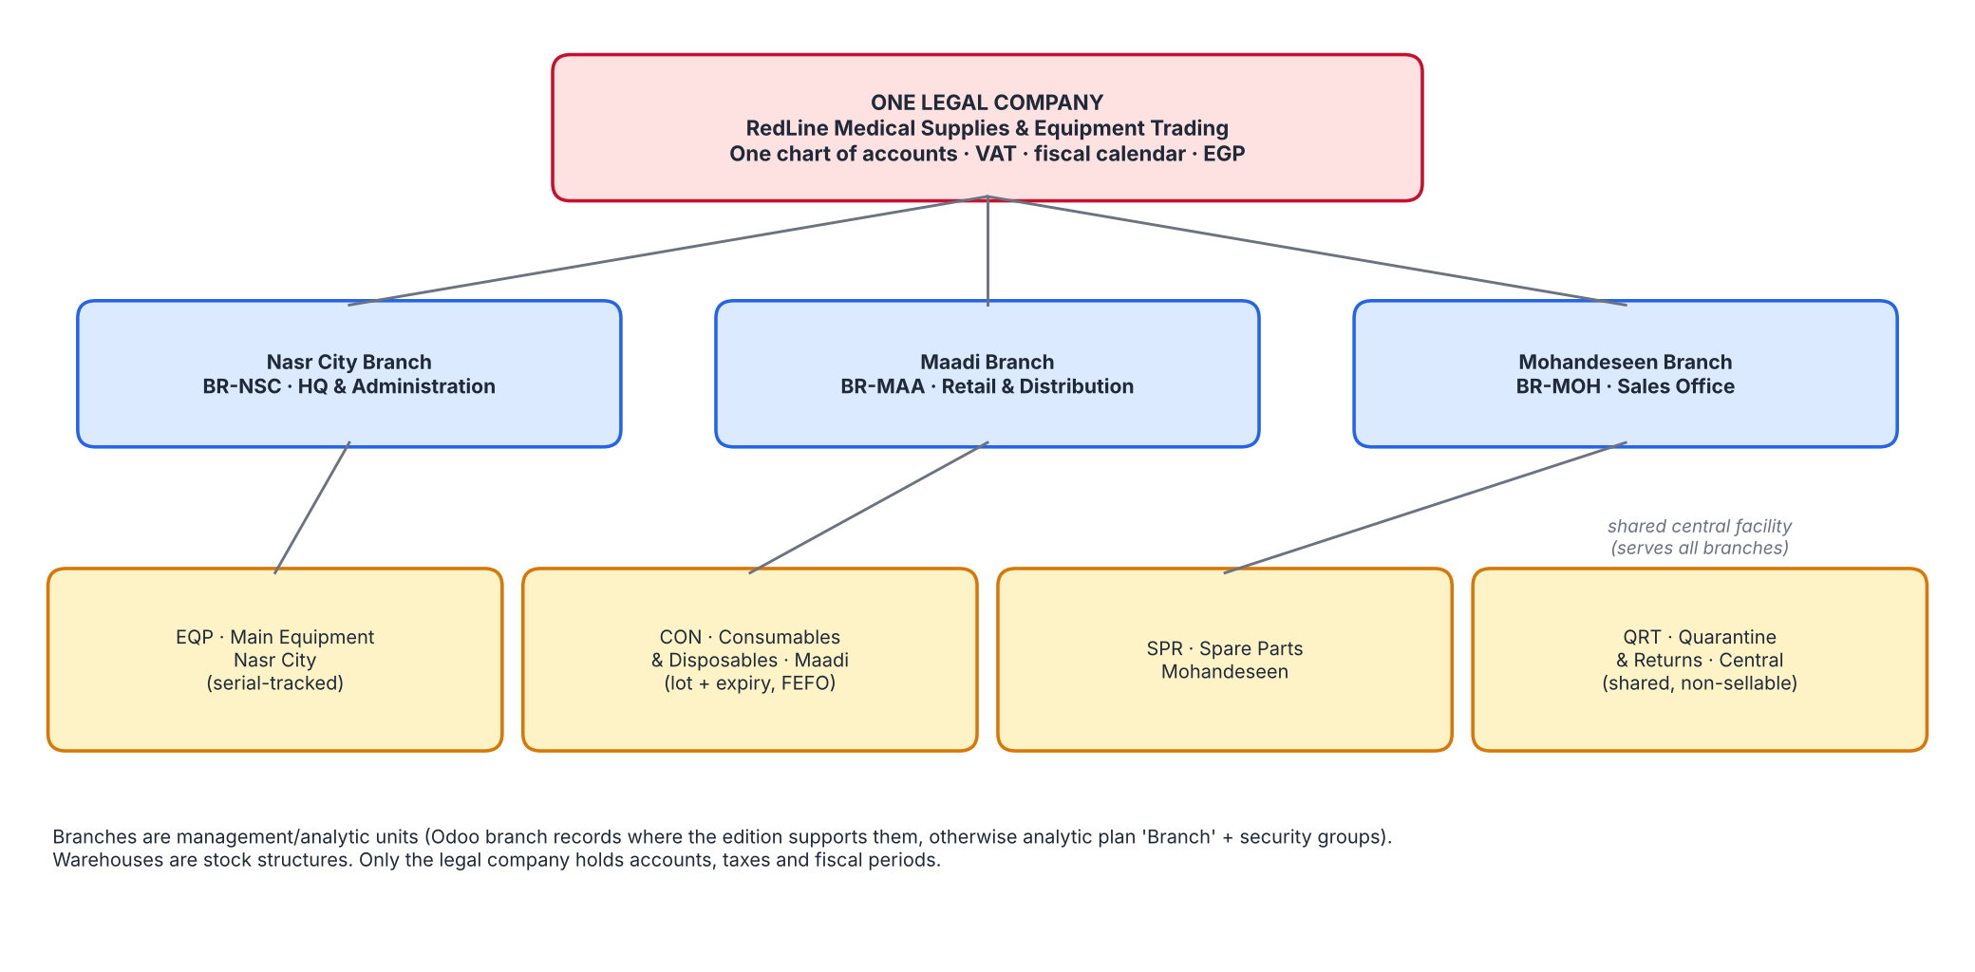
Company profile
نبذة عن الشركة
Who RedLine is
■ Cairo-based trader of medical equipment, consumables, disposables and spare parts
■ HQ: 45 Makram Ebeid St, Nasr City, Cairo, Egypt
■ Email: info@redlinemedical.com.eg | Currency: EGP
■ One legal company, 3 branches, 4 warehouses
■ 24 products: 10 equipment (serial), 10 consumables (lot + expiry), 4 spare parts
■ 13 customers and 6 vendors (illustrative)
87
27
20.9%
sales orders
purchase orders
gross margin (simulated)
RedLine Medical Supplies & Equipment Trading | Odoo ERP Graduation Project (simulation) | Period 1 May 2026 – 30 September 2026
2 / 18

Slide 3
Business background and current challenges
الخلفية والتحديات
Simulated legacy / manual baseline
Area | As-is | Consequence
Stock & lots | Stock cards in spreadsheets; expiry on cartons | Expired stock sold; slow recalls
Serial equipment | Serials on paper delivery notes | Weak warranty and traceability
Credit | Balances in spreadsheet; 45-60 day hospitals | Over-exposure; slow collection
Returns | Returned goods back on shelf | Unreported losses; risk to patients
Accounting | Quarterly count; late adjustments | Margins and stock value unknown until close
Branches | Results compiled manually | No single view of performance
RedLine Medical Supplies & Equipment Trading | Odoo ERP Graduation Project (simulation) | Period 1 May 2026 – 30 September 2026
3 / 18

Slide 4
Project objectives and expected outcomes
الأهداف والنتائج المتوقعة
■ Full lot / serial / expiry traceability with FEFO picking
■ Quarantine of failed, returned, damaged and near-expiry stock
■ Automated valuation reconciled to the ledger monthly
■ Credit control and ageing for institutional customers
■ Branch-level sales and margin visibility
■ Bilingual Arabic / English documents (RTL)
75
77
requirements with IDs and acceptance criteria
UAT test cases
29
101
gaps analysed (GAWF)
accounts in proposed chart
RedLine Medical Supplies & Equipment Trading | Odoo ERP Graduation Project (simulation) | Period 1 May 2026 – 30 September 2026
4 / 18

Slide 5
Project scope and exclusions
النطاق والاستثناءات
In scope
Out of scope / not claimed
■ Contacts, Sales, CRM, Purchase, Inventory, Accounting
■ Warehouses, routes, lots, serials, expiry, FEFO
■ Chart of accounts, journals, VAT, valuation
■ Master data and 5-month simulated operations
■ Documentation set, import package, validation
■ Live Odoo installation, import or functional testing
■ Payroll, manufacturing, e-commerce, POS hardware
■ Statutory tax filing and e-invoicing integration
■ Custom module build (optional, priced in FPD)
RedLine Medical Supplies & Equipment Trading | Odoo ERP Graduation Project (simulation) | Period 1 May 2026 – 30 September 2026
5 / 18

Slide 6
Project team and responsibilities
فريق المشروع
Five members, all register tasks at 100% (documentation level)
Mohamed Mahmoud Abdel Bary
Mohamed Essam El-Din Youssef
Ahmed Mahmoud Mohamed
Fathy Adel Fathy
Omnia Haitham
Team Leader - Apps, Settings, Permissions & Design
Sales & CRM
Inventory & Data Upload
Purchase, Quality & Testing
Accounting & Finance
■ App installation, general settings, companies and branches
■ Users, access rights, record rules and approval workflows (permissions)
■ Solution design, GAWF, SSD and final integration of all documents
■ Project governance, presentation and final review
■ Sales and CRM configuration: pipeline, quotations, pricelists, sales teams
■ Customer master data and contract pricing (preparing and uploading files)
■ BRD, RTM and business process documentation
■ Sales and CRM test scenarios and business acceptance
■ Inventory configuration: warehouses, locations, routes, lots, serials, expiry, FEFO
■ Product master, opening stock and reordering rules
■ Data upload: preparing and importing all CSV files and data quality checks
■ Technical proposal, go-live plan and package validation
■ Purchase configuration: vendors, RFQ and PO, approvals, vendor pricelists
■ Quality inspection, receipts follow-up and supplier returns
■ UAT execution, defect log and test documentation
■ User's guide, training and final quality assurance
■ Accounting configuration: chart of accounts, journals, taxes, payment terms
■ Invoices, bills, payments, credit notes, bank and cash
■ Opening balances, stock valuation and financial reconciliations
■ Financial proposal (FPD) and accounting test scenarios
RedLine Medical Supplies & Equipment Trading | Odoo ERP Graduation Project (simulation) | Period 1 May 2026 – 30 September 2026
6 / 18

Slide 7
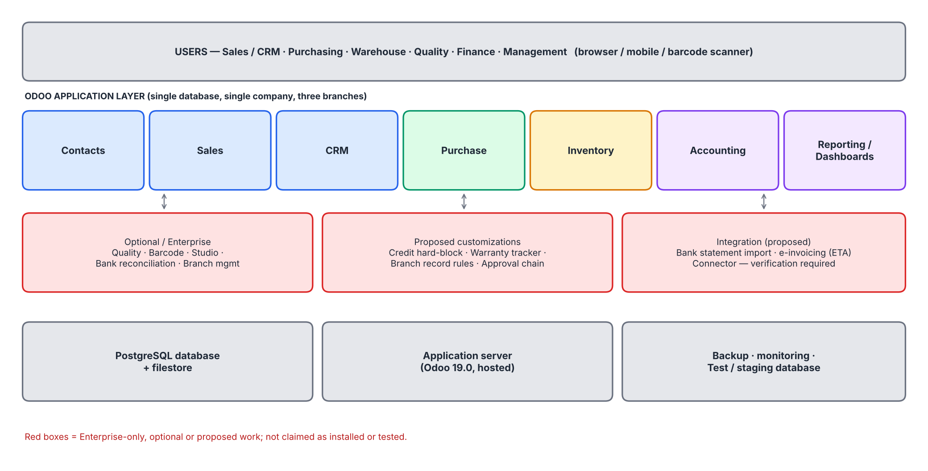
Odoo architecture and selected modules
هيكل النظام والوحدات
Odoo 19.0 (Enterprise edition assumed)
■ Standard: Contacts, Sales, CRM, Purchase, Inventory (+ Product Expiry), Accounting
■ Enterprise / optional: Quality, Barcode, Studio
■ Proposed customizations: credit hard-block, warranty tracker, branch record rules, approvals
RedLine Medical Supplies & Equipment Trading | Odoo ERP Graduation Project (simulation) | Period 1 May 2026 – 30 September 2026
7 / 18

Slide 8
Branch and warehouse structure
الفروع والمخازن
Single legal company; branches are reporting units, warehouses are stock structures
Code | Warehouse | Branch | Purpose
EQP | Main Equipment Warehouse - Nasr City | BR-NSC | Receiving, storage and dispatch of capital medical equipment (serial-tracked)
CON | Medical Consumables & Disposables Warehouse - Maadi | BR-MAA | Lot- and expiry-tracked consumables; FEFO picking; retail counter supply
SPR | Spare Parts Warehouse - Mohandeseen | BR-MOH | Spare parts, filters and batteries for installed equipment
QRT | Quarantine & Returns Warehouse - Central Cairo | BR-NSC | Isolation of failed-inspection, returned, damaged and near-expiry stock pending disposition
Branch | Role
Nasr City Branch (BR-NSC) | Main Headquarters and Administration - 45 Makram Ebeid St, Nasr City, Cairo, Egypt
Maadi Branch (BR-MAA) | Retail and Distribution - 18 Road 9, Maadi, Cairo, Egypt
Mohandeseen Branch (BR-MOH) | Sales Office - 22 Syria St, Mohandeseen, Greater Cairo, Egypt
Limits of standard branch handling: separate branch balance sheets, branch-specific numbering and warehouse-level access need branch records (edition-dependent) or proposed customizations.
RedLine Medical Supplies & Equipment Trading | Odoo ERP Graduation Project (simulation) | Period 1 May 2026 – 30 September 2026
8 / 18

Slide 9
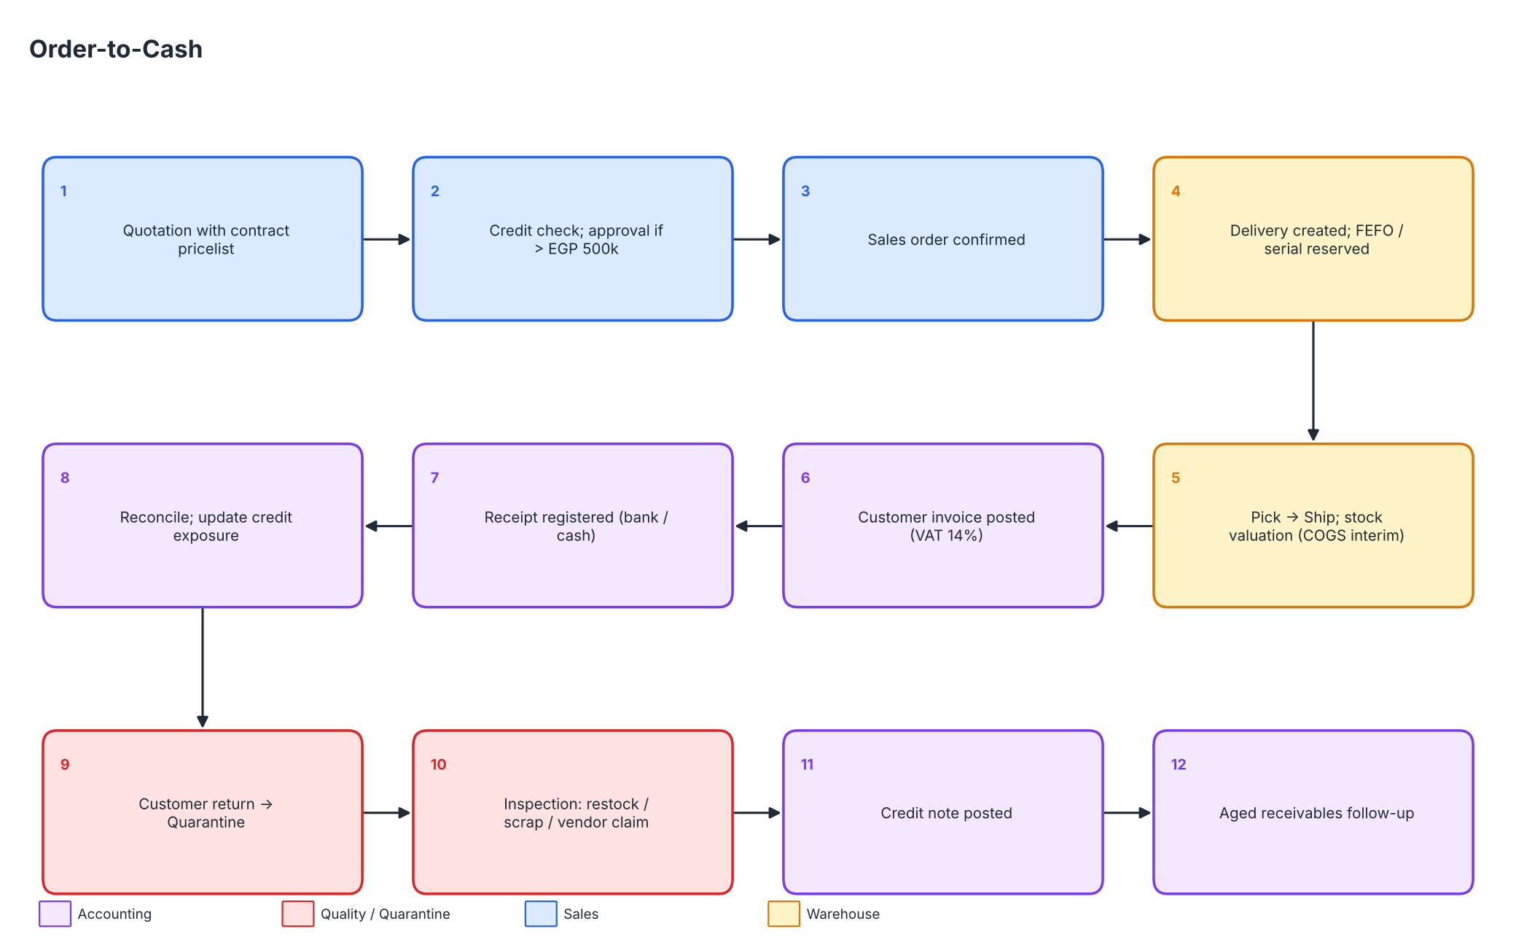
Core workflow 1: Order-to-Cash
دورة المبيعات
RedLine Medical Supplies & Equipment Trading | Odoo ERP Graduation Project (simulation) | Period 1 May 2026 – 30 September 2026
9 / 18

Slide 10
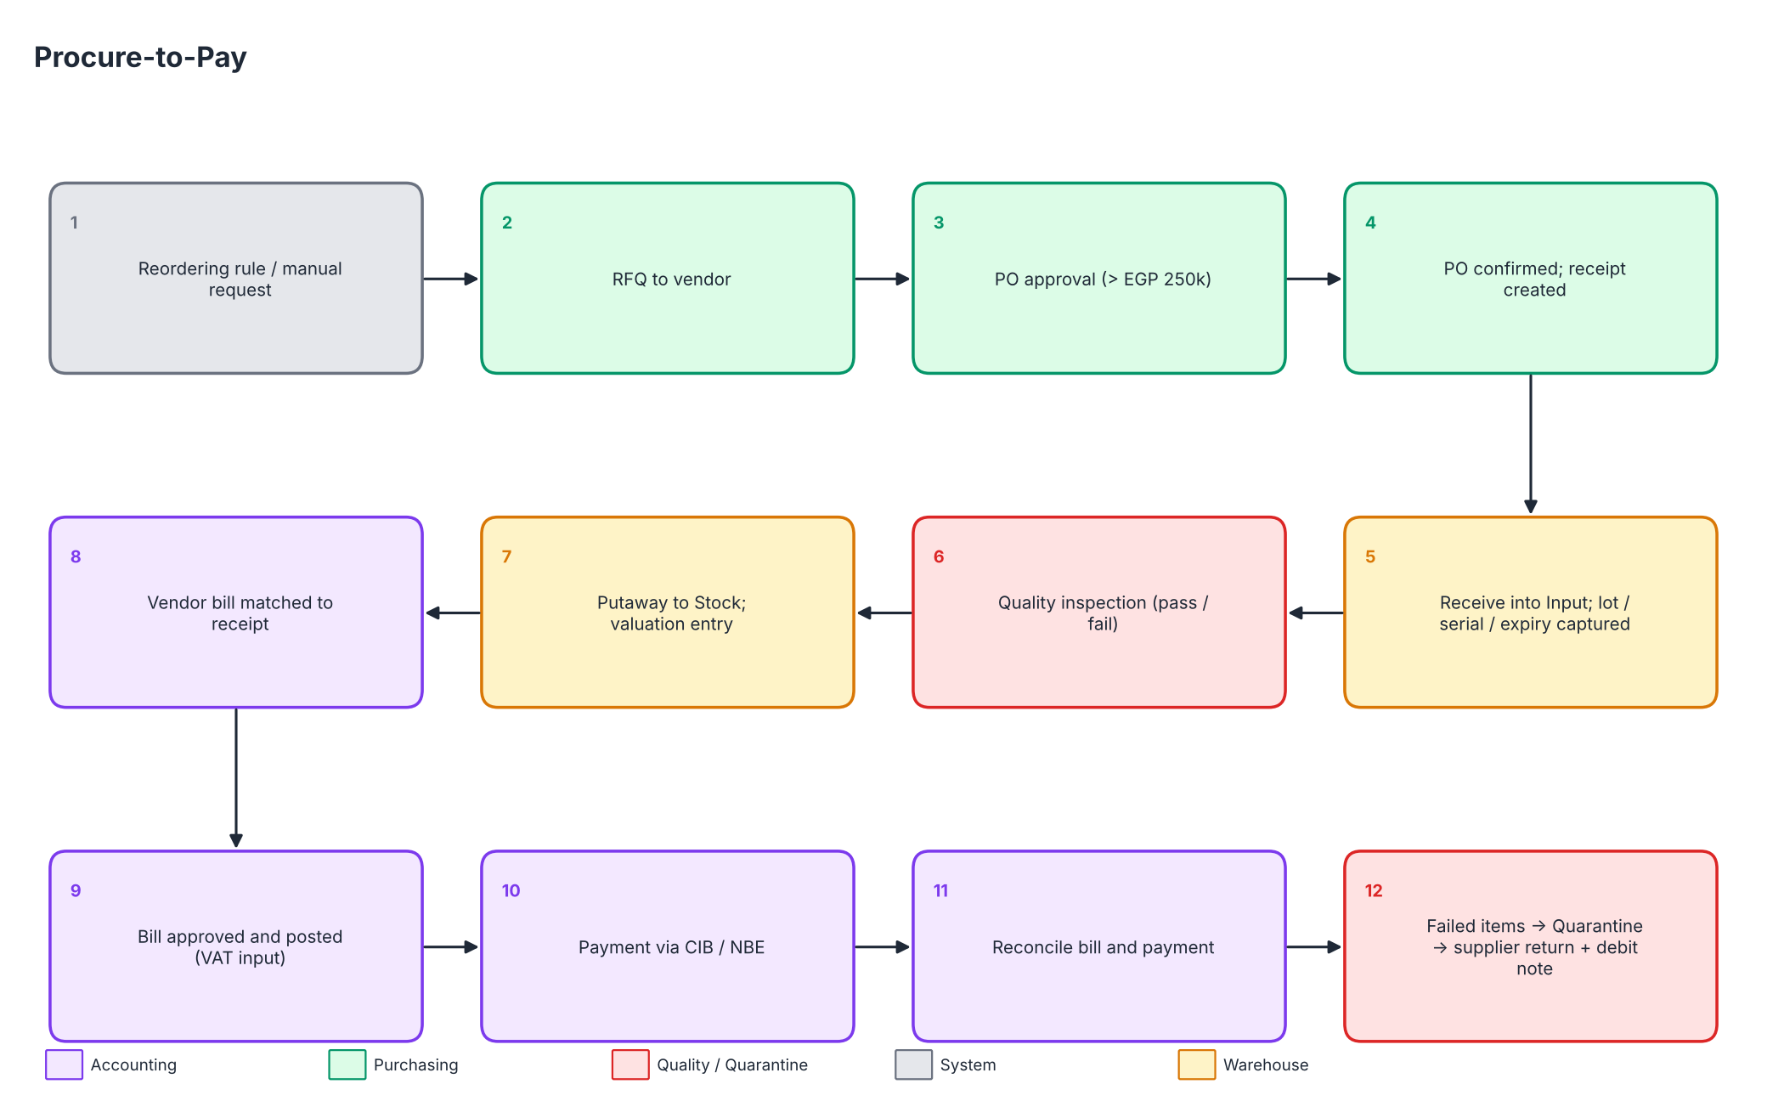
Core workflow 2: Procure-to-Pay
دورة المشتريات
RedLine Medical Supplies & Equipment Trading | Odoo ERP Graduation Project (simulation) | Period 1 May 2026 – 30 September 2026
10 / 18

Slide 11
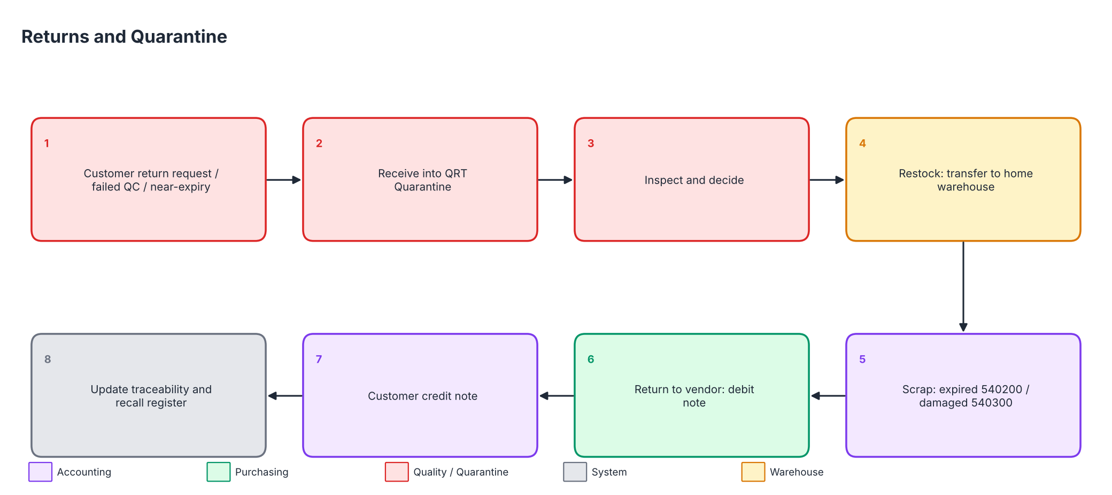
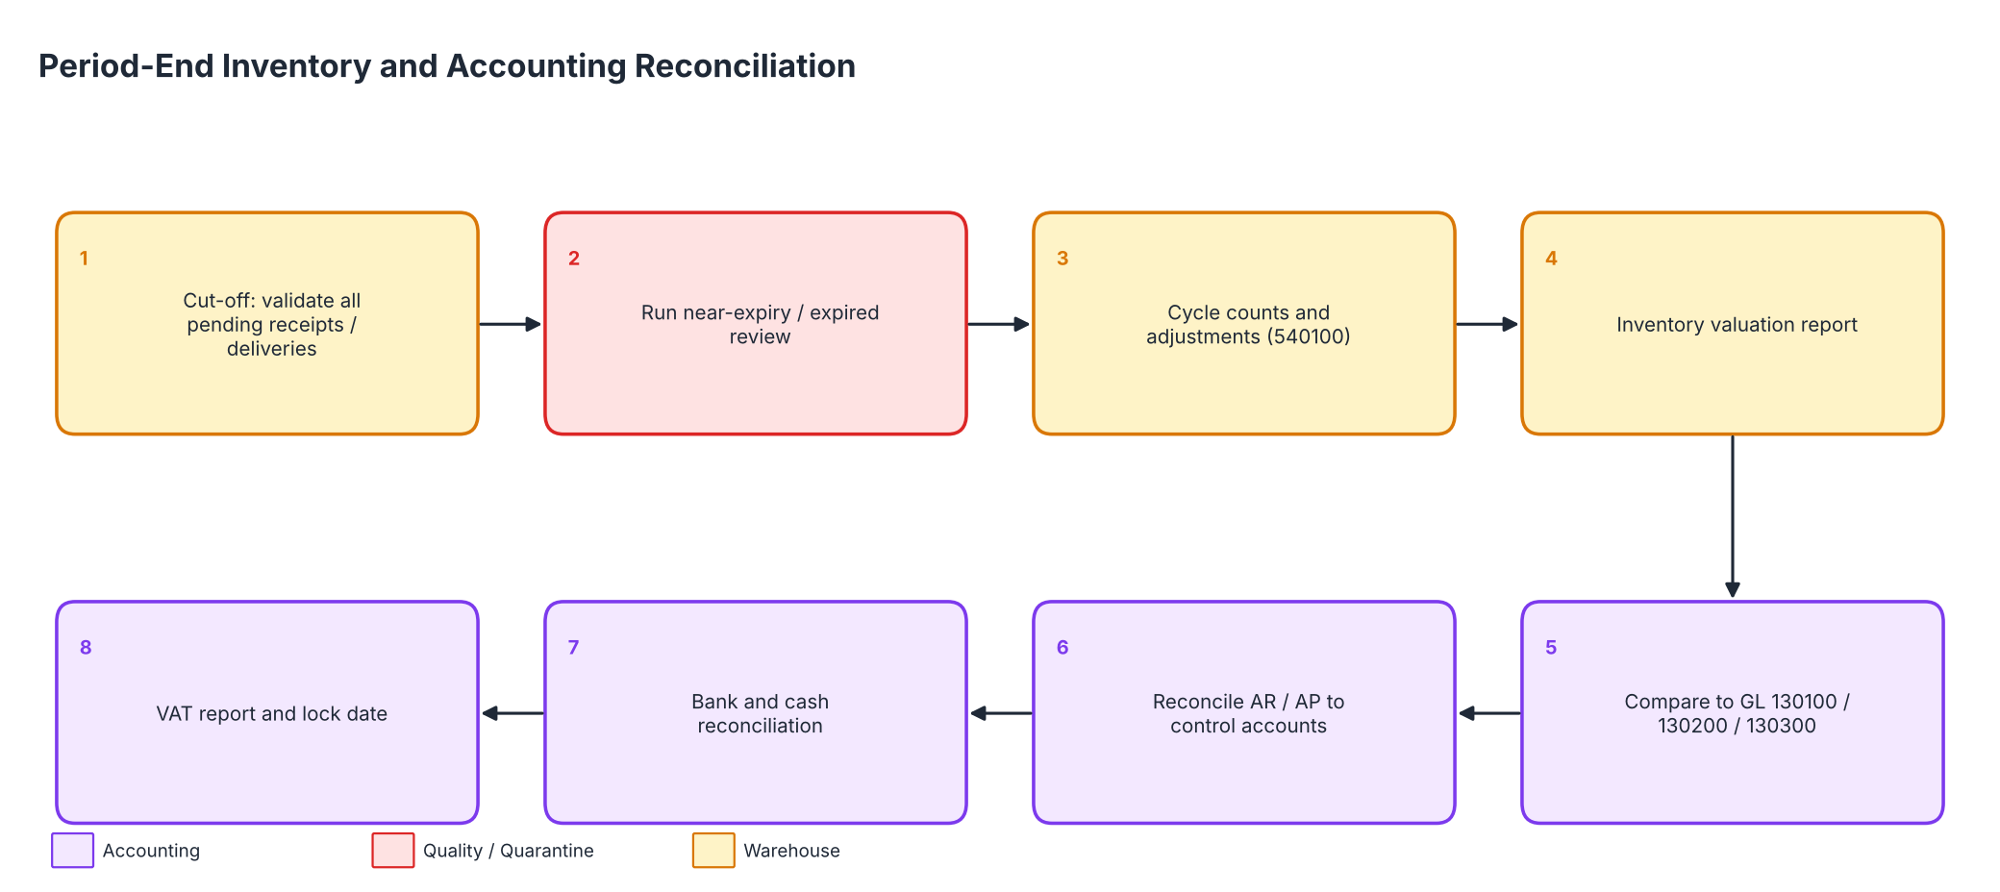
Workflow 3: Returns, quarantine, period close
المرتجعات والحجر والإقفال
■ Returned / failed / near-expiry goods go to the Quarantine & Returns warehouse (excluded from sale)
■ Disposition: restock, vendor return with debit note, or scrap to 540200 / 540300
■ Month-end: valuation vs GL, AR/AP vs control accounts, lock date
RedLine Medical Supplies & Equipment Trading | Odoo ERP Graduation Project (simulation) | Period 1 May 2026 – 30 September 2026
11 / 18

Slide 12
Accounting design
التصميم المحاسبي
Account mapping connects categories, valuation, revenue, COGS and adjustments
Category | Valuation | Revenue | COGS
Equipment | 130100 | 410100 | 510100
Consumables | 130200 | 410200 | 510200
Spare parts | 130300 | 410300 | 510300
■ 101 accounts, 6 digits, hierarchical groups; proposed chart - accountant review required
■ Journals: INV, BILL, STJ, MISC, OPEN + CIB1, NBE1 (simulated banks) + 3 branch cash safes
■ FIFO, automated valuation, Anglo-Saxon (stock interim 130600 / GRNI 210500); VAT 14% assumed
■ Simulated trial balance: 737 entries, balanced
RedLine Medical Supplies & Equipment Trading | Odoo ERP Graduation Project (simulation) | Period 1 May 2026 – 30 September 2026
12 / 18

Slide 13
Inventory tracking: lots, serials, expiry and FEFO
تتبع المخزون
186
42
548
serial-tracked units
lot / batch rows
stock moves (5 months)
■ Equipment: unique serial per unit; warranty end date per delivered serial (proposed tracker)
■ Consumables: lot + expiry; FEFO removal; lots < 60 days excluded from sale and isolated monthly
■ Quarantine warehouse: returns, failed QC, damaged and near-expiry stock
■ Identity checked for every product and warehouse: Opening + In - Out = Closing
■ Simulated losses: expired EGP 46,000, damaged EGP 55,795, count differences EGP 6,405
RedLine Medical Supplies & Equipment Trading | Odoo ERP Graduation Project (simulation) | Period 1 May 2026 – 30 September 2026
13 / 18

Slide 14
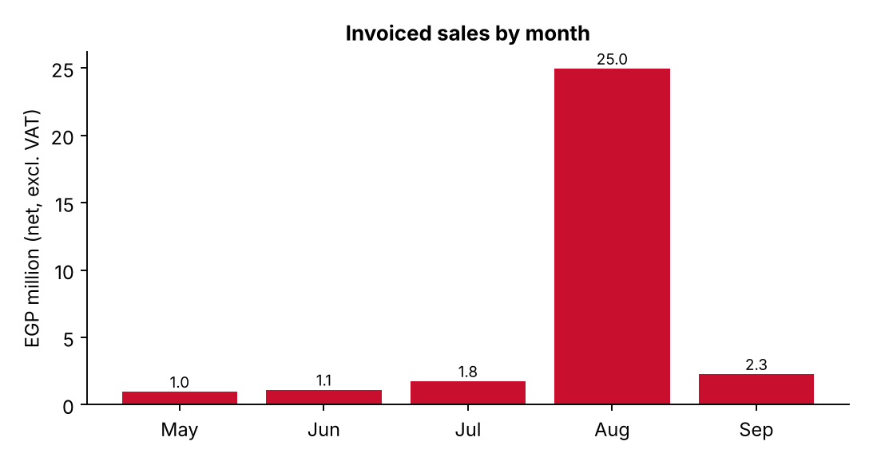
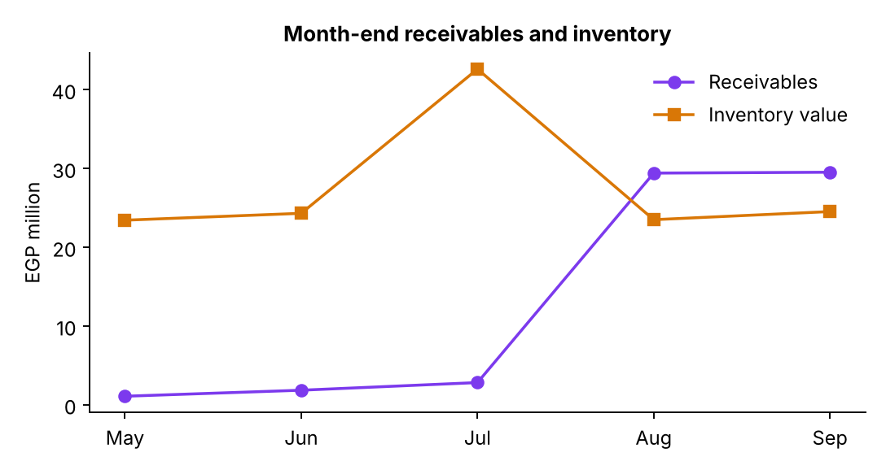
Simulated five-month results
نتائج المحاكاة
1 May 2026 – 30 September 2026 (EGP, excl. VAT)
EGP 30,233,232
EGP 6,330,266
EGP 29,532,073
EGP 2,662,739
net sales after credit notes
gross profit (20.9%)
receivables 30-Sep
payables 30-Sep
One MRI system sale (EGP 23,438,252, August) is about 77% of five-month sales; without it net sales are EGP 6,794,980.
RedLine Medical Supplies & Equipment Trading | Odoo ERP Graduation Project (simulation) | Period 1 May 2026 – 30 September 2026
14 / 18

Slide 15
Migration approach and validation strategy
نهج الترحيل والتحقق
Step | Action | Validation
1 | Chart of accounts, journals, taxes | 101 accounts, unique codes
2 | Warehouses, locations, categories | 4 warehouses, 10 categories
3 | Products, partners | 24 products, 13 customers, 6 vendors
4 | Lots, serials, opening stock | Qty per lot/serial; value vs ledger
5 | Reordering rules, history reference | Counts and keys
■ CSV import package (16 files) + README with order, dependencies and limits
■ A set of CSV files is not an Odoo backup; settings, routes, taxes and rules are manual
■ Automated validation script: keys, duplicates, dates, quantity and value reconciliation
RedLine Medical Supplies & Equipment Trading | Odoo ERP Graduation Project (simulation) | Period 1 May 2026 – 30 September 2026
15 / 18

Slide 16
UAT and project completion status
الاختبار وحالة الإنجاز
100%
77
50
27
project tasks completed (documentation)
UAT test cases
passed - simulated review
not executed - needs live Odoo
■ 100% means the documented deliverable exists - not that Odoo was installed
■ Passed (simulated review) = reviewed against the scenario and simulated data; evidence is simulated
■ Enterprise, customization, security and performance items need live verification
■ All 75 requirements have at least one test case (RTM)
RedLine Medical Supplies & Equipment Trading | Odoo ERP Graduation Project (simulation) | Period 1 May 2026 – 30 September 2026
16 / 18

Slide 17
KPIs, expected benefits and risks
المؤشرات والمخاطر
KPI | Target / simulated
Recall trace time | < 15 min per lot
Expired lots sold | 0 (lots < 60 days excluded)
Valuation vs GL difference | 0 or explained
Gross margin | 20.9% (simulated)
Risk | Mitigation
Branch limits in standard Odoo | Analytic plan, groups, custom rules
Enterprise features missing | Manual checklists
VAT / tax settings | Accountant review
Import errors | Rehearsal + reconciliation
Expected benefits: faster recalls, fewer expiry losses, accurate perpetual stock value, credit control, branch visibility, bilingual documents.
RedLine Medical Supplies & Equipment Trading | Odoo ERP Graduation Project (simulation) | Period 1 May 2026 – 30 September 2026
17 / 18

Slide 18
Conclusion and next steps
الخلاصة والخطوات التالية
■ Delivered: complete document set, 16-file CSV import package, validation report - consistent and reconciled
■ Design answers the key business risks: traceability, quarantine, valuation, credit, branches
■ Honest status: simulation only; Enterprise and customization items require live verification
Next steps
■ Confirm Odoo version / edition and branch-management availability
■ Stand up staging; import package; rehearse migration (see Go-Live and Deployment Plan)
■ Execute UAT on staging; close the 'not executed' tests
■ Accountant review of chart, VAT, withholding, e-invoicing obligations
شكراً لكم - Thank you
RedLine Medical Supplies & Equipment Trading | Odoo ERP Graduation Project (simulation) | Period 1 May 2026 – 30 September 2026
18 / 18

